Slide 1
Facial Landmarks Detection with Synthetic Dataset
CMPT 732-G200 Project Milestone
Chaoyi Hu
Student # 301559775
Nov 14, 2022

Slide 2
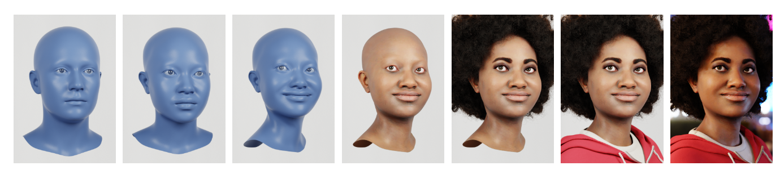
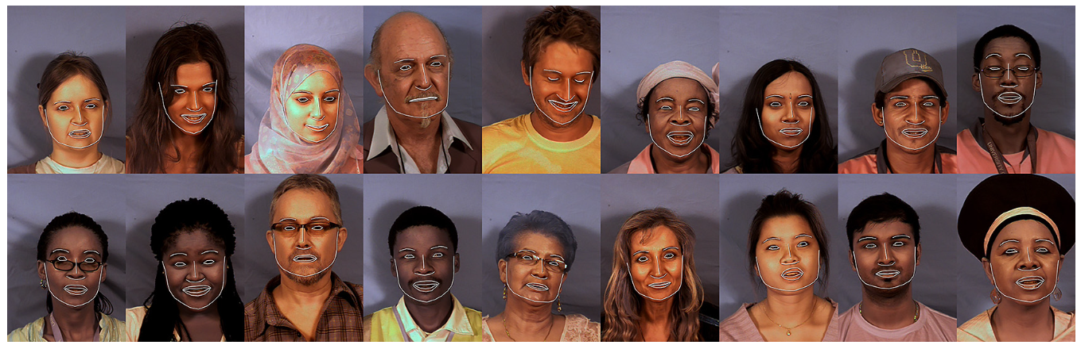
Background
Synthetic Facial Data
Controllable production
Accurate annotations
No ethical concerns
Other advantages
Demands for mobility
Lightweight: consumer devices
Fast: run in real time
Graph: https://microsoft.github.io/FaceSynthetics/

Slide 3
Problem Statement
Synthetic Facial Data
Controllable production
Accurate annotations
No ethical concerns
Other advantages
Demands for mobility
Lightweight: consumer devices
Fast: run in real time
Develop a Facial landmarks model that:
Trains on synthetic facial images
Evaluates on real facial images
Inference on consumer devices
In real time, FPS ≥ 30

Slide 4
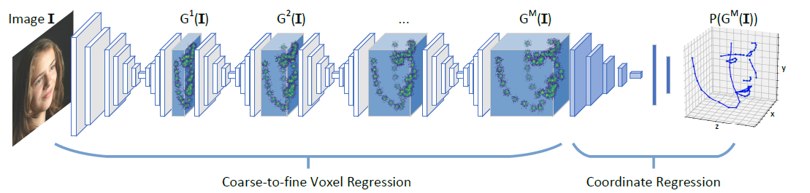
Inputs & Outputs
2D Human facial images
without depth information
3D facial landmarks positions
Graph: Zhang et al. 2018. Joint Voxel and Coordinate Regression for Accurate 3D Facial Landmark Localization.

Slide 5

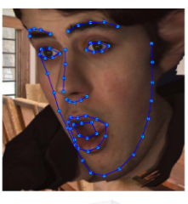
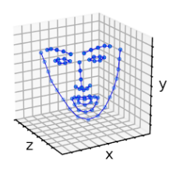
Inputs & Outputs
Expected final result: Application on consumer devices (desktop demo)
Takes human facial images cropped from video frames
Predicts and visualize 3D landmarks in real time at ≥ 30 FPS
Schematic figure

Slide 6
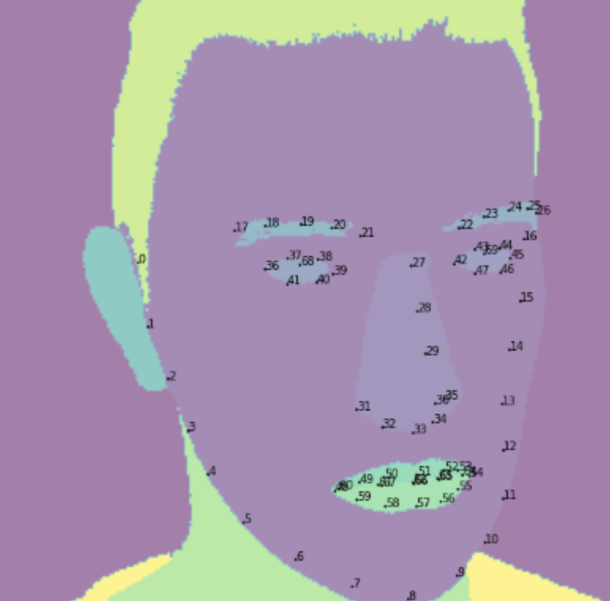
Datasets
Train & Validation
The Face Synthetics dataset
100,000 Synthetic 2D human facial images with 70-point 2D landmarks positions
Test
AFLW2000-3D
2000 Real-world 2D human facial images with image-level 68-point 3D facial landmarks annotations
https://github.com/microsoft/FaceSynthetics
http://www.cbsr.ia.ac.cn/users/xiangyuzhu/projects/3DDFA/main.htm
70-point: 2 extra points in the middle of L and R eye

Slide 7
Pipeline
Face Detection Module
(Obtain accurate face crop)
Landmarks Prediction Module
(Obtain landmark locations)
2D image
3D coordinates
Ref: https://arxiv.org/pdf/1801.09242.pdf
https://google.github.io/mediapipe/solutions/face_mesh.html

Slide 8
Progress so far
Facial detection
Implemented classic facial detection using dlib
Implemented BlazeFace using MediaPipe
Landmarks Prediction
Implemented facial prediction using dlib pre-trained landmarks model
Developed a demo framework
Reproduced the mediapipe residual network, training it with synthetic data

Slide 9
Pipeline
Face Detection Module
(Obtain accurate face crop)
Landmarks Prediction Module
(Obtain landmark locations)
2D image
3D coordinates
Ref: https://arxiv.org/pdf/1801.09242.pdf
https://google.github.io/mediapipe/solutions/face_mesh.html

Slide 10
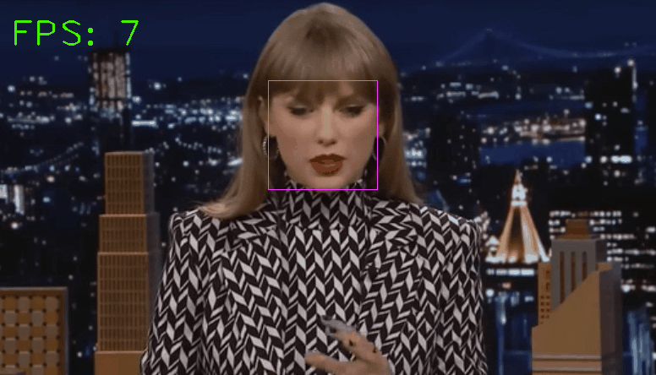
Pipeline – Facial Detection
Face detection module
Classic HOG feature combined with a linear classifier, an image pyramid, and sliding window detection scheme (dlib implementation)
Slow
Avg time for face Detection: 131.67 ms per frame
Avg processing rate: 7.29 FPS
http://dlib.net/face_detector.py.html

Slide 11
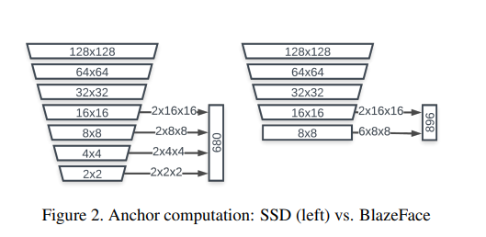
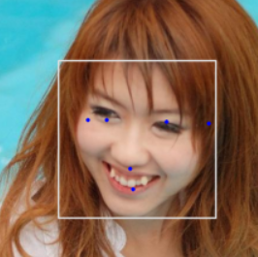
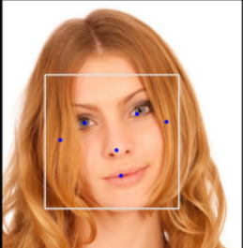
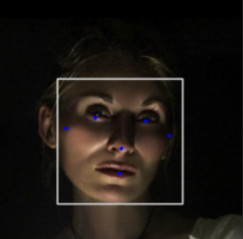
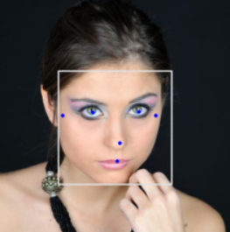
Pipeline – Facial Detection
Face detection module
Improved
BlazeFace (MediaPipe implementation, pre-trained)
Lightweight, Fast
BlazeFace detection tested on AFLW2000 data
https://google.github.io/mediapipe/solutions/face_detection.html
Graph: https://arxiv.org/abs/1907.05047

Slide 12
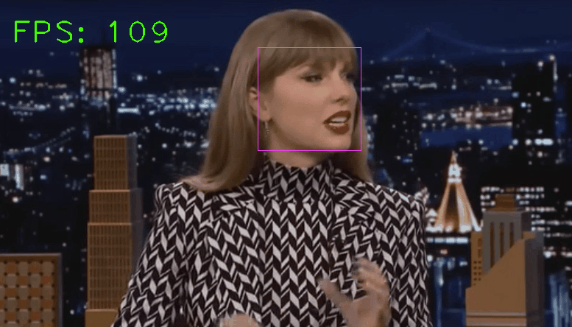
Pipeline – Facial Detection
Face detection module
Improved
BlazeFace (MediaPipe implementation, pre-trained)
Lightweight, Fast
Avg time for face Detection: 11.91 ms per frame
Avg processing rate: 83.35 FPS
https://google.github.io/mediapipe/solutions/face_detection.html

Slide 13
Pipeline – Landmarks
Pipeline Demo for Desktop
Face Detection Module
(Obtain accurate face crop)
Landmarks Prediction Module
(Obtain landmark locations)
Ref: https://arxiv.org/pdf/1801.09242.pdf
https://google.github.io/mediapipe/solutions/face_mesh.html

Slide 14
Pipeline – Landmarks
Network Architecture
b×3×192×192
FaceMesh Block
=
Backbone
( )×14
Conv2D
( )×14
MaxPool2D
(if stride==2)
Conv2D
+
( )×3
PReLU
https://google.github.io/mediapipe/solutions/face_mesh.html#face-detection-model
https://github.com/thepowerfuldeez/facemesh.pytorch
b×1
b×68×3
Confidence (face being present)
Coordinates (3D 68-points)

Slide 15
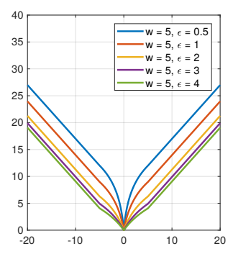
Pipeline – Landmarks
Implementation
Implementation
Added BatchNorm layers (after Conv2D in FaceMesh Block)
Optimizer: Adam
Wing Loss (w=5, curvature=0.5)
PyTorch
https://arxiv.org/pdf/1711.06753.pdf

Slide 16
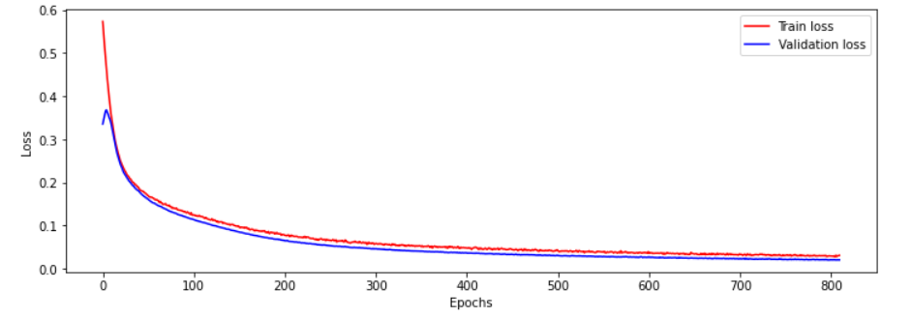
Pipeline – Landmarks
Training
Training
Added BatchNorm layers (after Conv2D in FaceMesh Block)
Wing Loss (w=5, curvature=0.5)
800 epochs, batch_size = 10, lr=2*10e-6
Optimizer: Adam
Trained on Google Colab
GPU Name: Persistence-M
Training time: 0 h 35 min 27 s
Model size: 1.2M
https://arxiv.org/pdf/1711.06753.pdf

Slide 17
Next step
Keep training the reproduced mediapipe model
Try using Enhanced NME loss (BMVC 2019, baseline available) https://bmvc2019.org/wp-content/uploads/papers/0772-paper.pdf
Try using volumetric components in reference to Joint Voxel and Coordinate Regression for Accurate 3D Facial Landmark Localization
Larger Dataset
Landmarks Desktop Demo
Miscellaneous functions for cropping, adapting, etc.

Slide 18
Pipeline – Landmarks
Face Detection Module
Landmarks Prediction Module
Volumetric likelihood representation
Stacked hourglass
3D coordinates regressor

Slide 19
Pipeline – Landmarks
Face Detection Module
Landmarks Prediction Module
Volumetric likelihood representation
Stacked hourglass
3D coordinates regressor

Slide 20
Pipeline – Landmarks
Face Detection Module
Landmarks Prediction Module
Volumetric likelihood representation
Stacked hourglass
3D coordinates regressor

Slide 21
Final demo
Report, project video and presentation
Pipeline Demo for Desktop
Face Detection Module
Landmarks Prediction Module
Volumetric likelihood representation
Stacked hourglass
3D coordinates regressor

Slide 22
Final demo
Report, project video and presentation
Pipeline Demo for Desktop
Face Detection Module
Landmarks Prediction Module
Volumetric likelihood representation
Stacked hourglass
3D coordinates regressor

